Slide 1
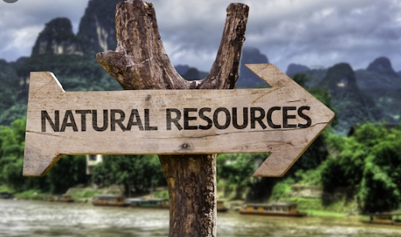

Slide 2
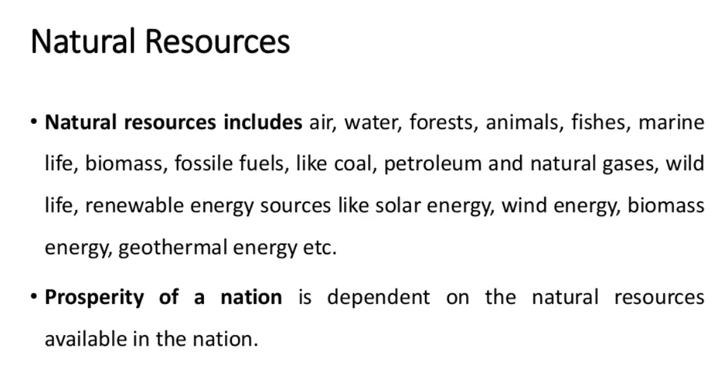

Slide 3
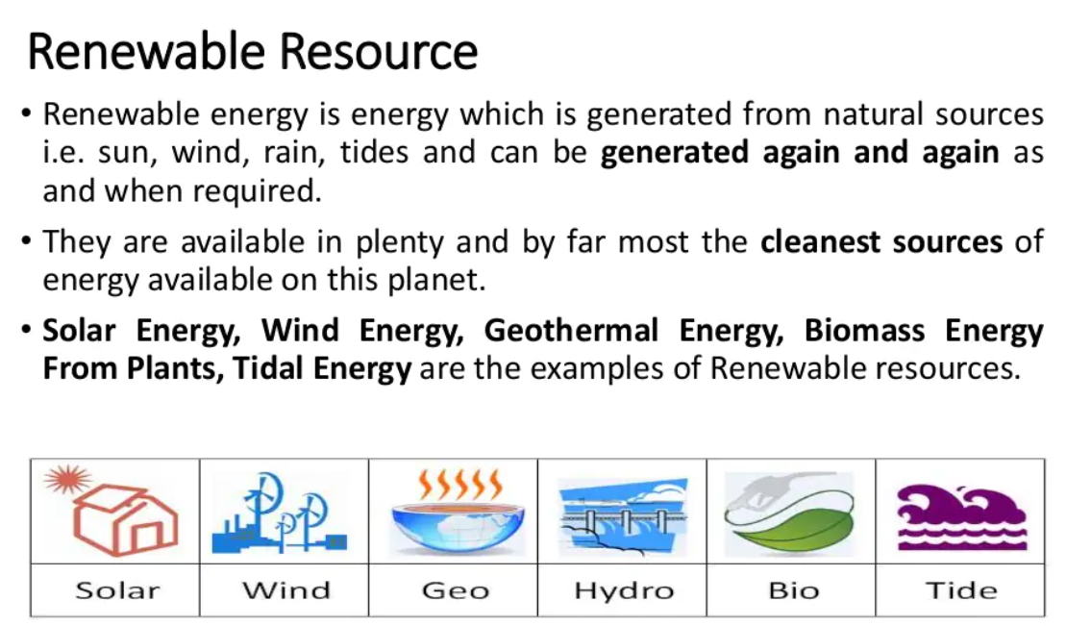

Slide 4
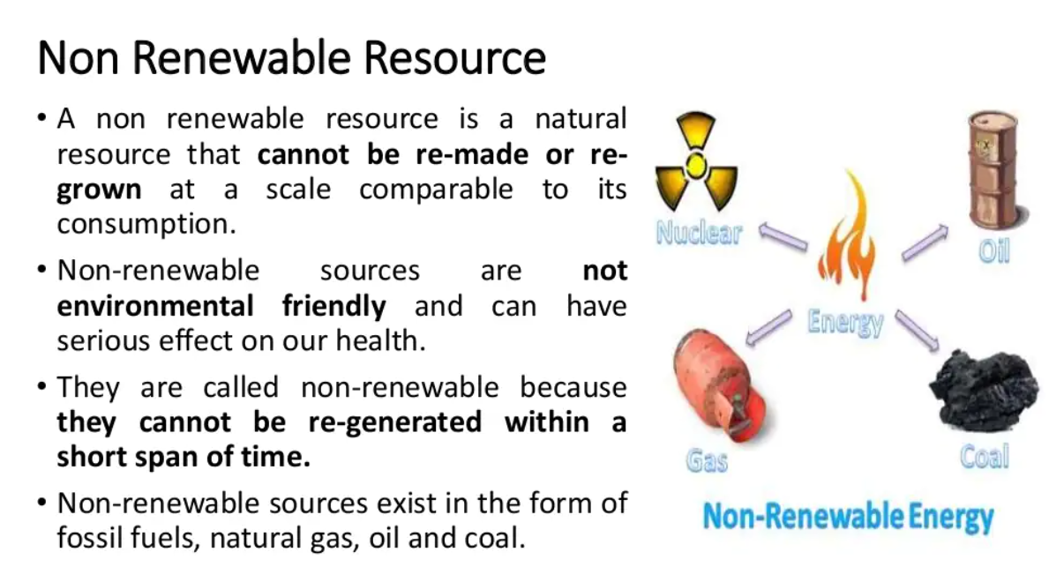

Slide 5
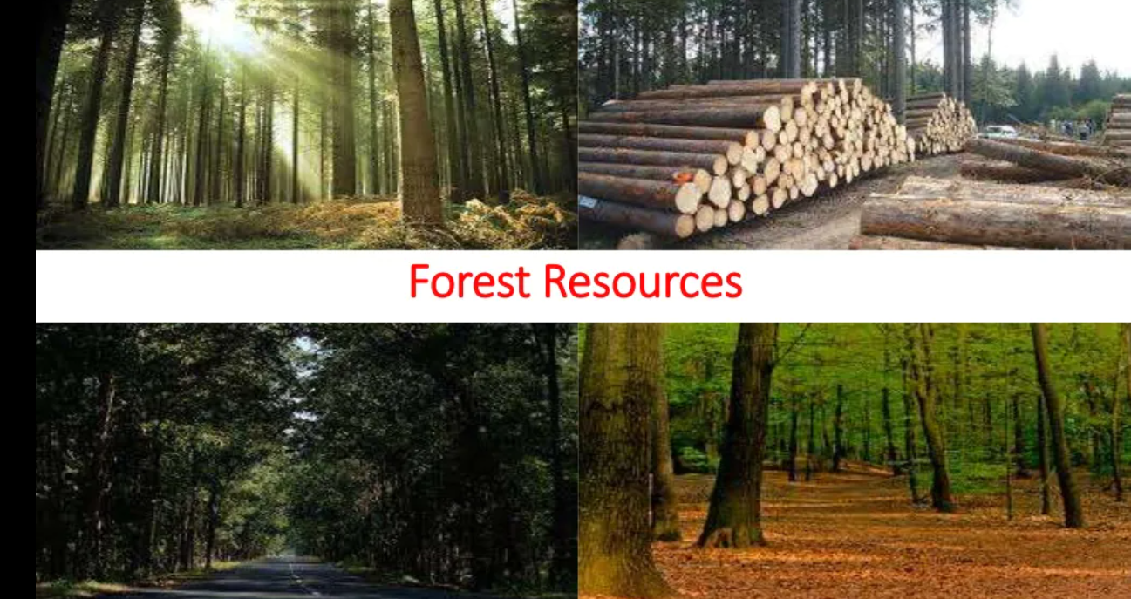

Slide 6
Forests in India…
In India, the forest cover is 6,97,898 sq.km(21.23%).
2.54% very dense forests (tree canopy density-TCD >70%),
9.7% moderately dense forests (TCD <70% >40%) and
9% open forests (TCD<40% >10%)
Largest forest cover is in Madhya Pradesh (77,522 sq.km)
Followed by Arunachal Pradesh (67,321 sq.km.) & Chhattisgarh (55,621 sq.km)

Slide 7
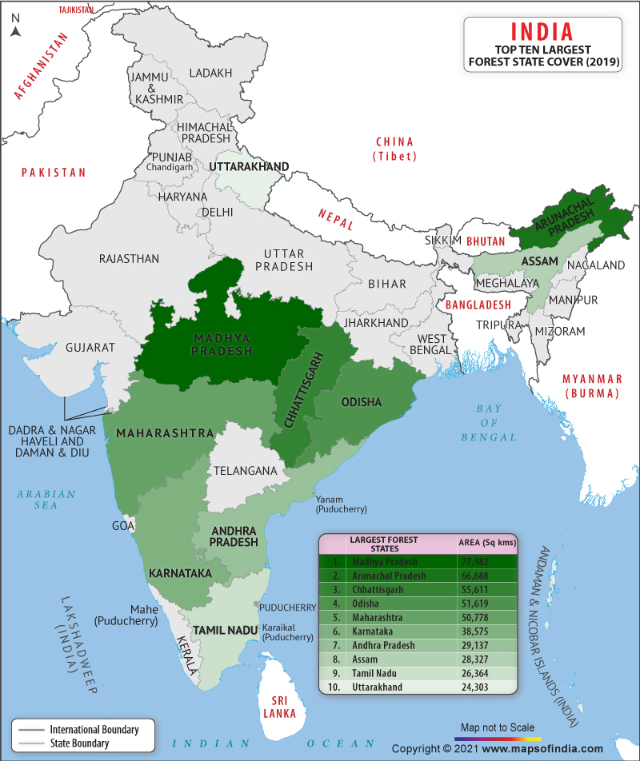

Slide 8
Why are they important?
Play a very crucial role in every nation’s economical, social and cultural activities
Many river systems originate in forests and anchor rich biodiversity.
Forests provide:
Timber
Industrial wood
Fuel wood
Pulp for paper and
Many non-timber products to the local communities and national economy.

Slide 9
Why are they important…
Valuable source of biodiversity & provide important ‘Gene-Pool’ from which we derive medicines, domesticated plants, animals etc.
Reduce the energy of rainfall (sponge action) and reduce soil erosion.
Also reduce floods; moderate climate and serve as sink for carbon dioxide.
Shelter for large number of animals species.

Slide 10
Impact of Forests
In India more than 2,00,000 villages are located in the fringe of forests.
More than 20 crore people (including 7 crore tribals) depend on forests for their livelihood.
About 3 crore people are directly involved in gathering & trading non-timber forest products like fruits, seeds, flowers, leaves, honey, gum etc.
Any impact on forest vegetation & biodiversity will have adverse implications for livelihood of forest-dependent communities.

Slide 11
Causes of deforestation
Increase in population
Urbanization & industrialization
Mineral exploration
Construction of dam reservoirs
Infrastructure development
Over grazing & Forest fires
Human encroachment & exploitation
Pollution-acid rain

Slide 12
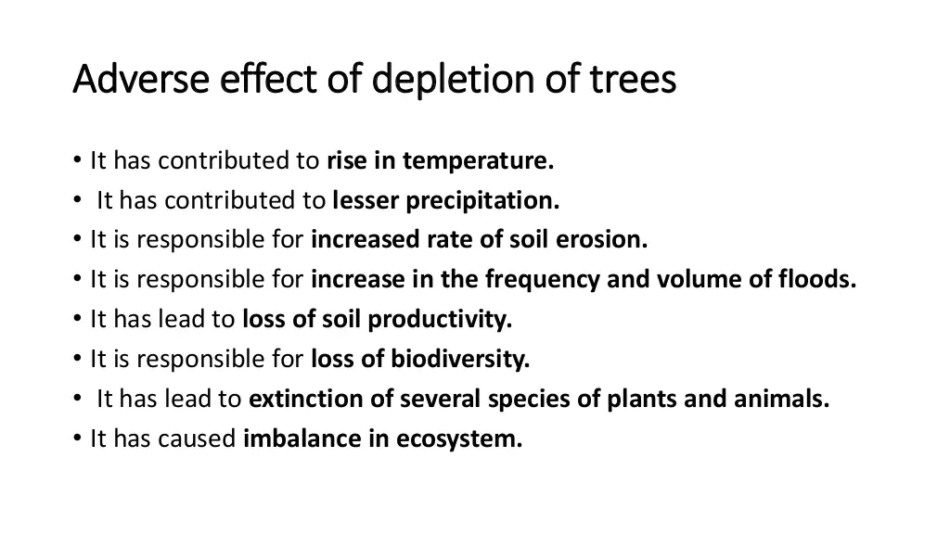

Slide 13
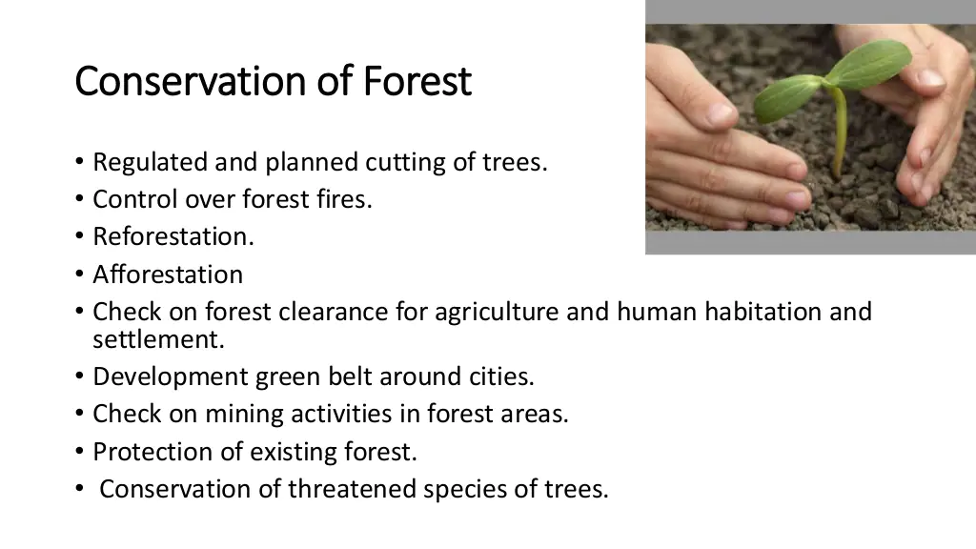

Slide 14
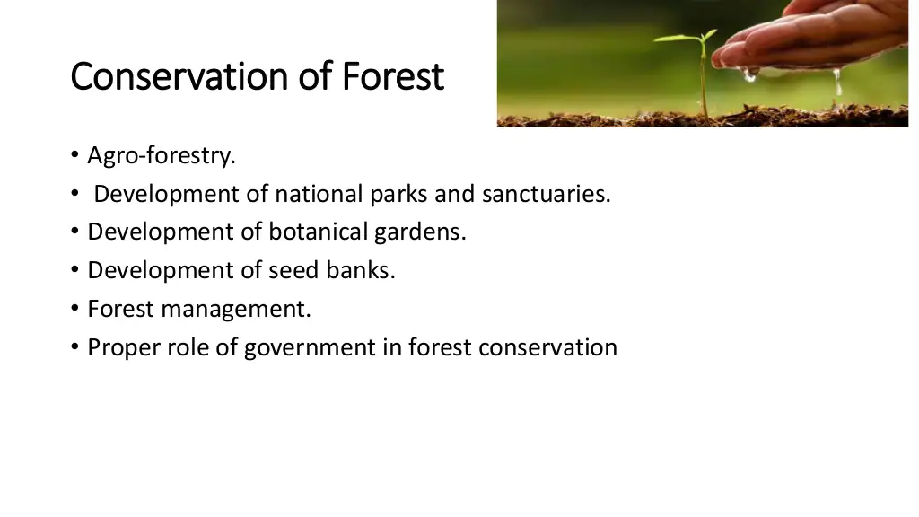

Slide 15
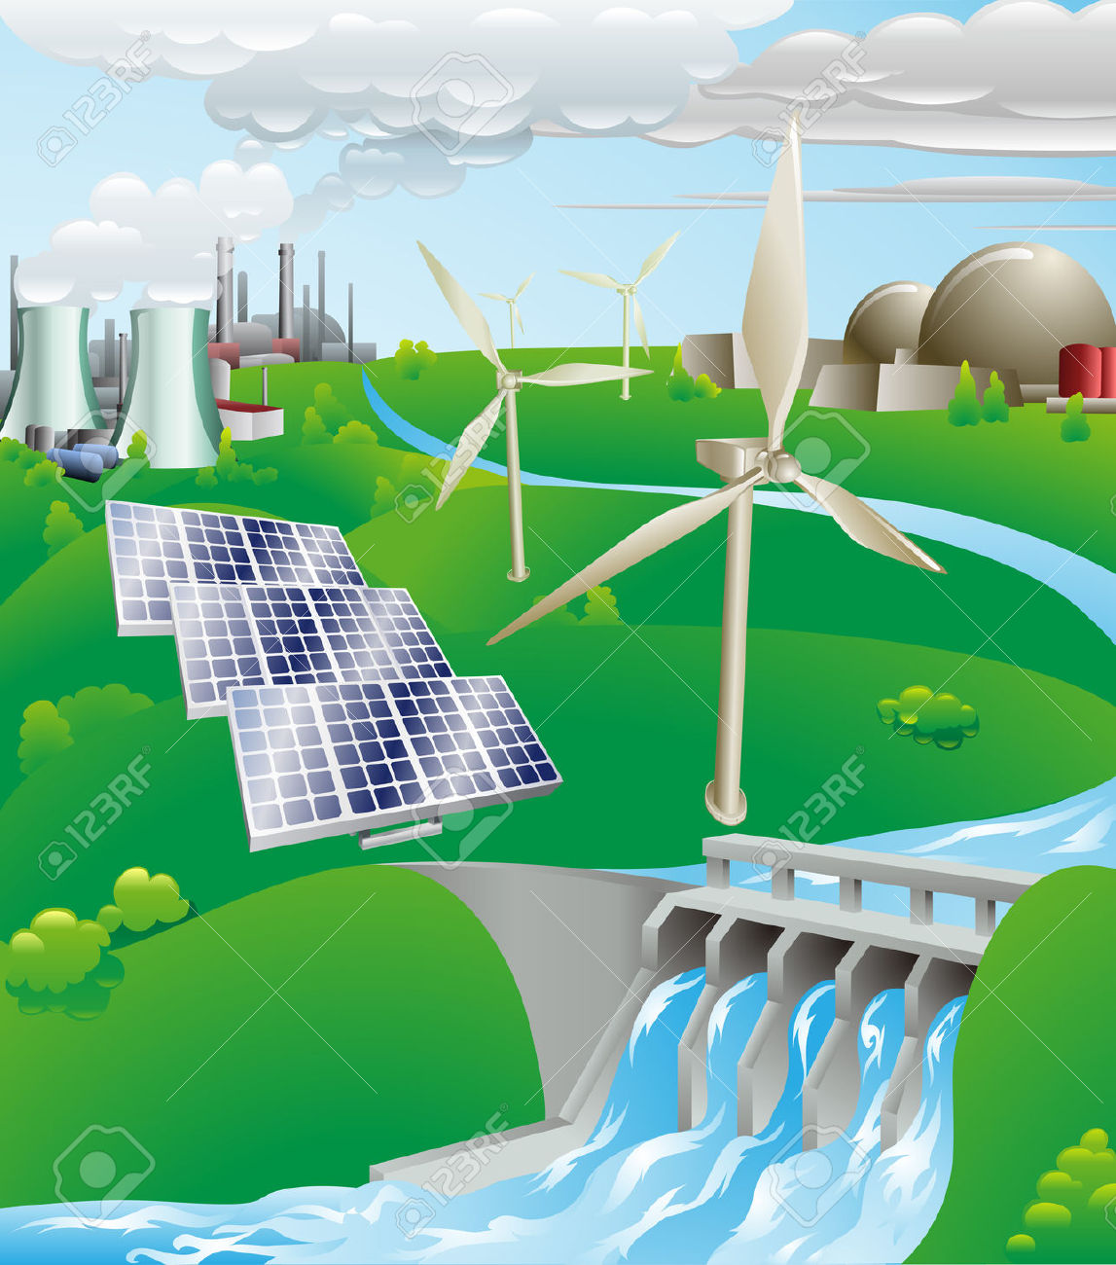
Energy Resources

Slide 16
Classification
Types
Renewable
Nonrenewable
Sustainable

Slide 17
Types of energy sources
Non-renewable
Fossil fuels : petroleum, coal, gas
Renewable
Wind
Wave [Tidal energy]
OTEC [Ocean thermal exchange capacitors]
Solar
Hydro-power
Hydrogen energy - Fuel-cells
Biofuels: biomass energy
Sustainable
Nuclear power

Slide 18
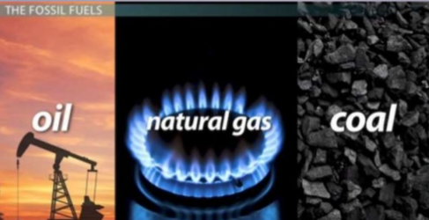
Non – renewable

Slide 19
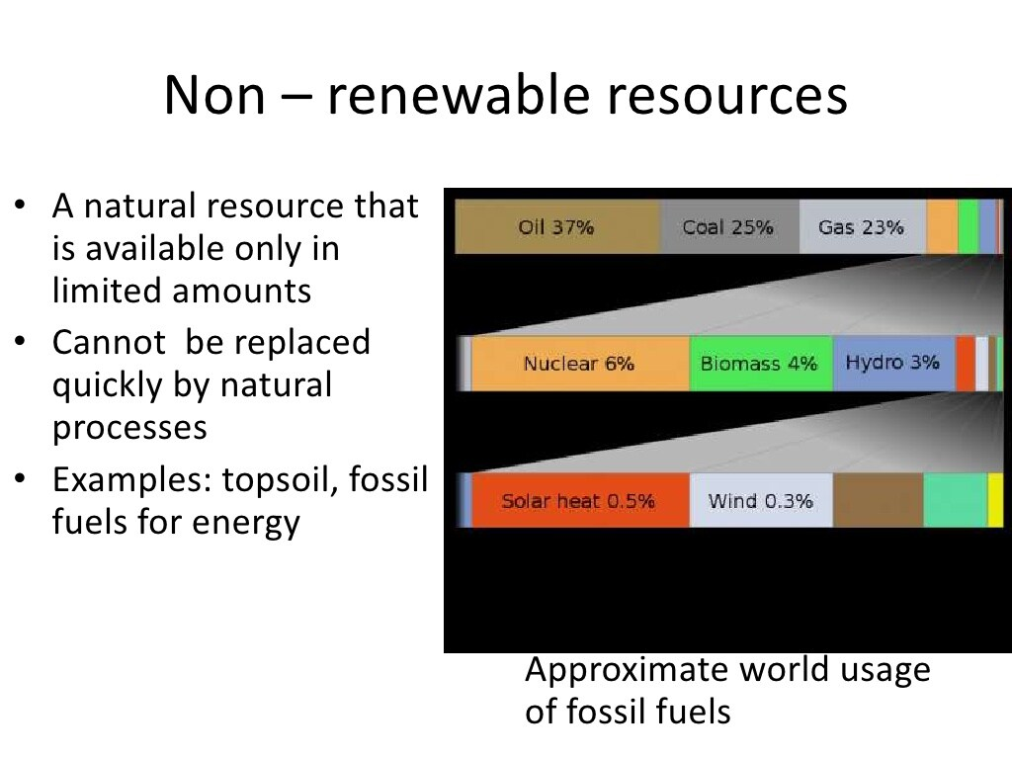

Slide 20
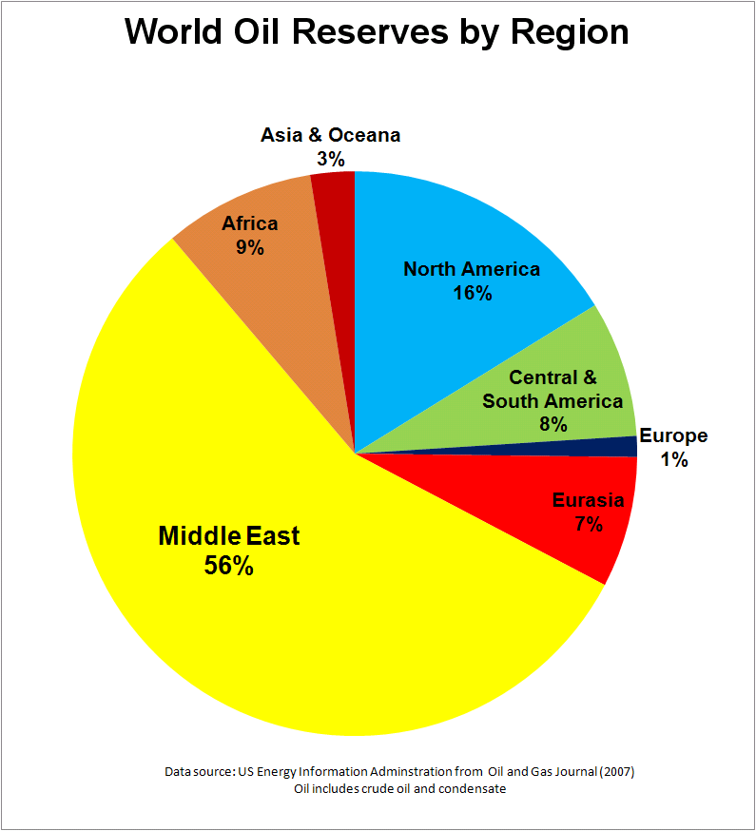

Slide 21
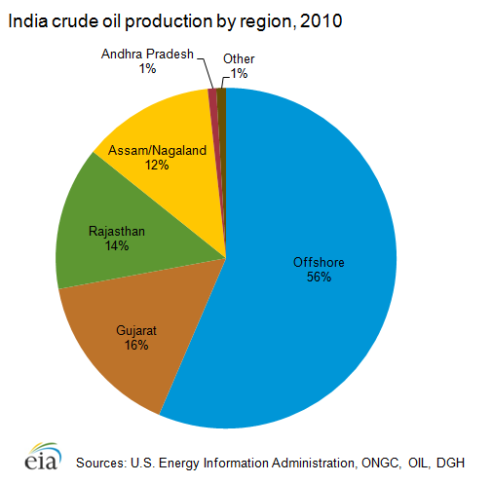
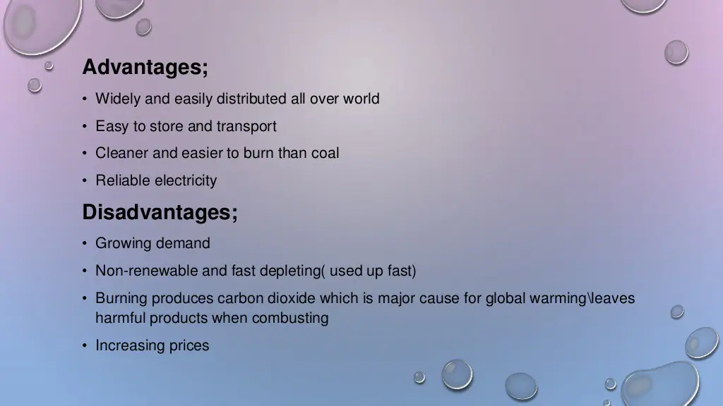

Slide 22
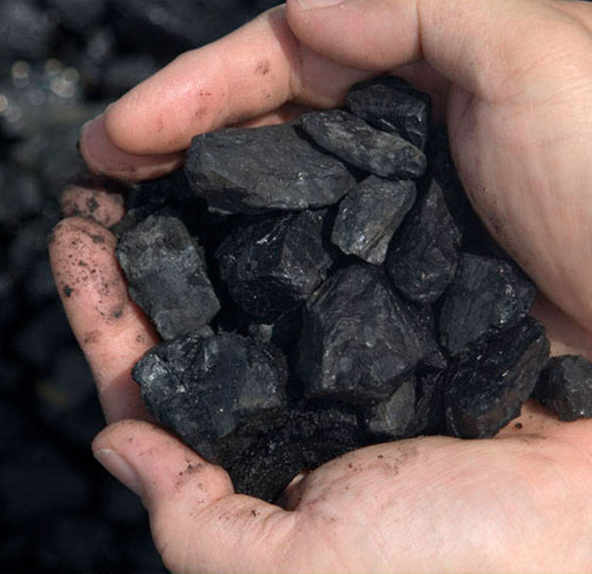
Non –renewable : Coal
Was the first fossil fuel to be used on an industrial scale.
Remains a major force in world energy.
Economically recoverable reserves exist in about 70 countries.
At the current rate of production, global coal reserves are estimated to last for almost another 150 years.

Slide 23
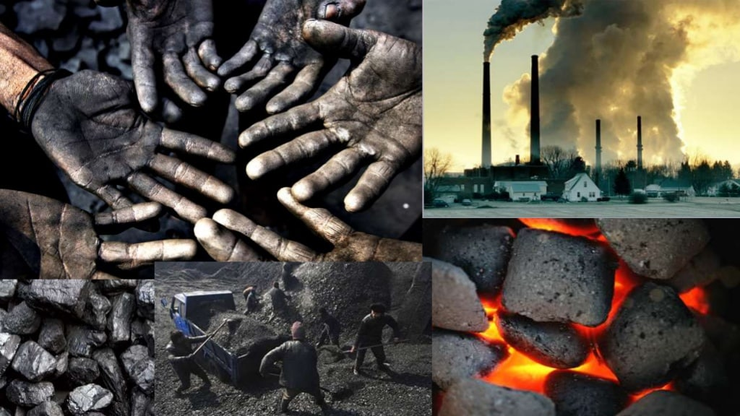

Slide 24
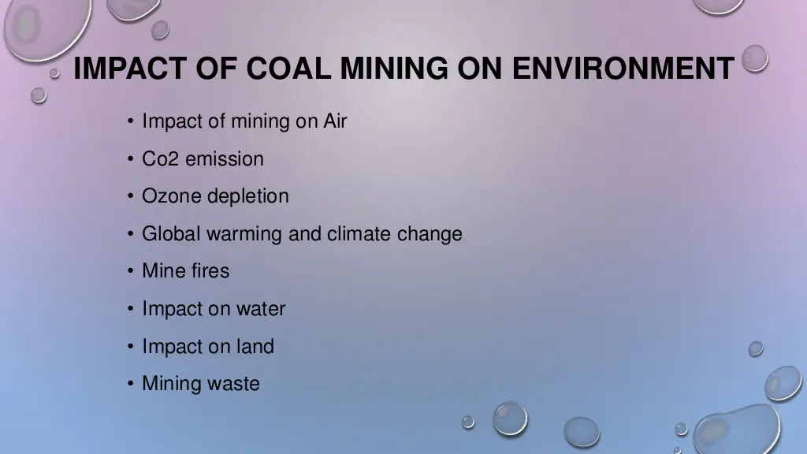

Slide 25
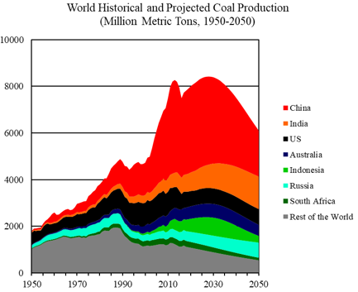
Data Sources : World Coal 2018-2050, World Energy Annual Report (Part 4)

Slide 26
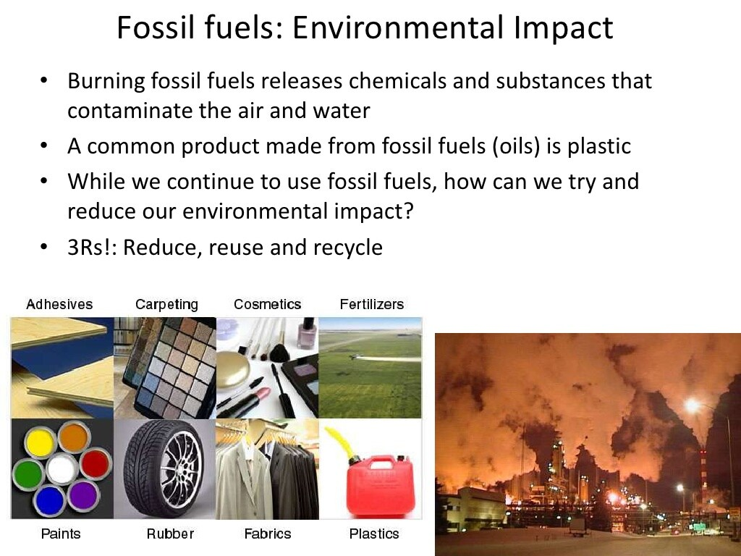

Slide 27
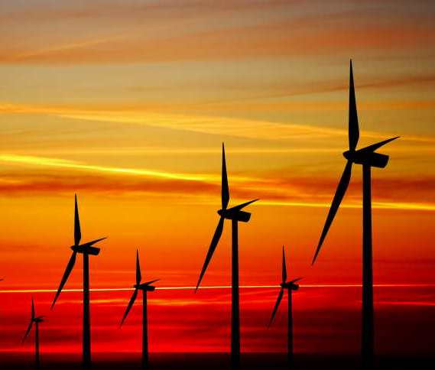
Renewable - Wind Energy
Source: wikimedia

Slide 28
So how do wind turbines make electricity?
Simply stated, a wind turbine works the opposite of a fan.
Instead of using electricity to produce wind, like a fan, wind turbines use wind to produce electricity.
The wind turns the blades, which spin a shaft, which connects to a generator and produces electricity.

Slide 29
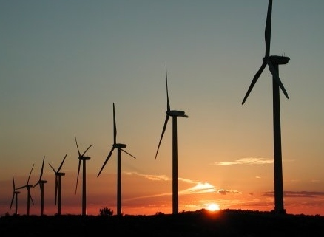
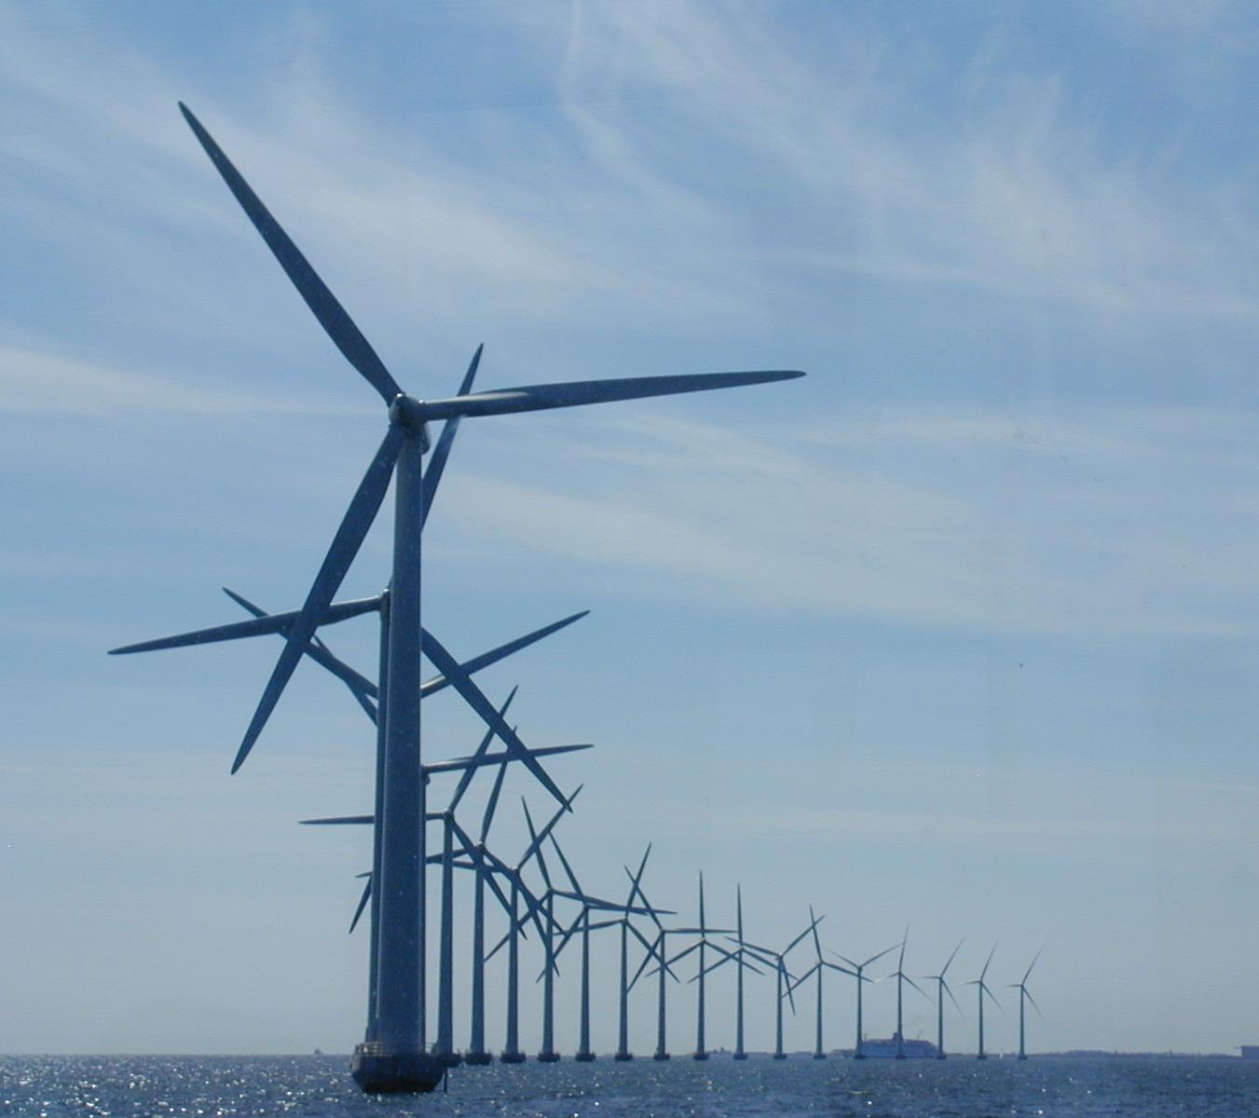
Wind Energy
Source: wikimedia

Slide 30
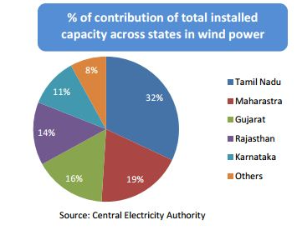
State-wise electricity produced from wind

Slide 31
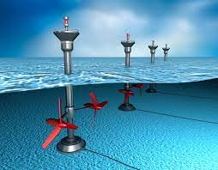
Wave -Tidal energy

Slide 32
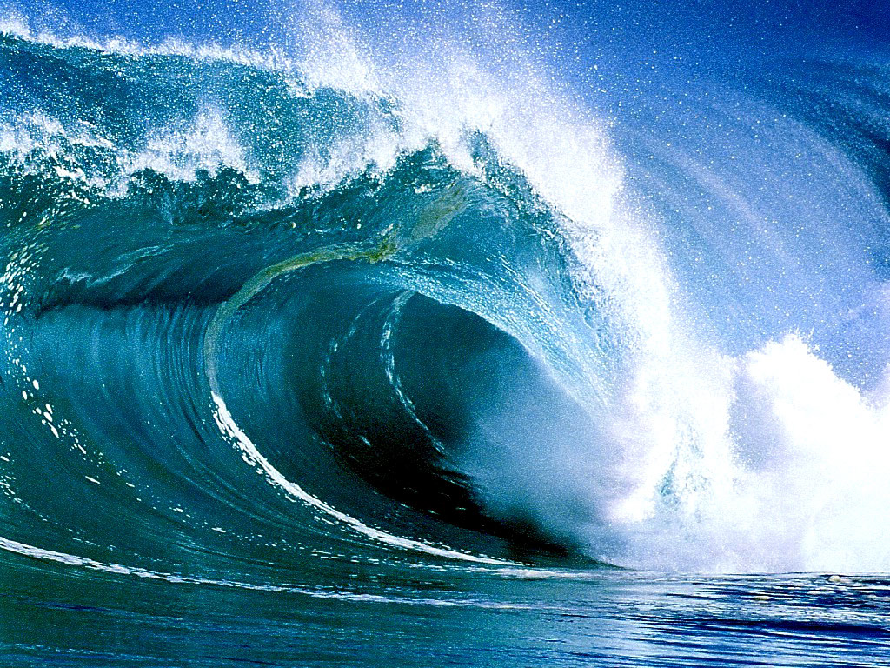
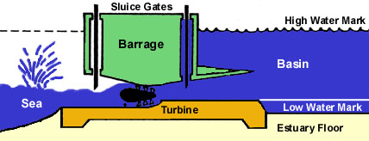
Turning Tides into Usable Energy
A dam (barrage) is built across the mouth of an estuary.
Sluice gates allow incoming tides to fill the basin.
As the tide ebbs(receding tide),
the water is forced through a turbine system to generate electricity.
Source: wikimedia

Slide 33
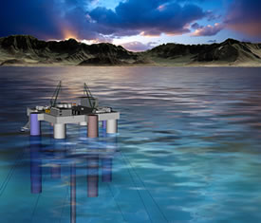
Ocean Thermal Energy Conversion (OTEC)
Source: wikimedia

Slide 34
Three basic ways to tap ocean for its energy
Waves : Kinetic energy of the moving waves in the ocean can be used to power a turbine.
Tidal energy (Renewable resource) : A difference of atleast 5m height between high and low tides is required for generating power.
Temperature difference in water.

Slide 35
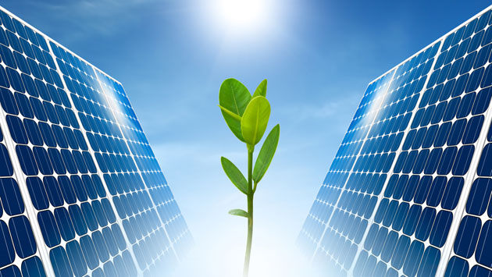
Solar energy

Slide 36
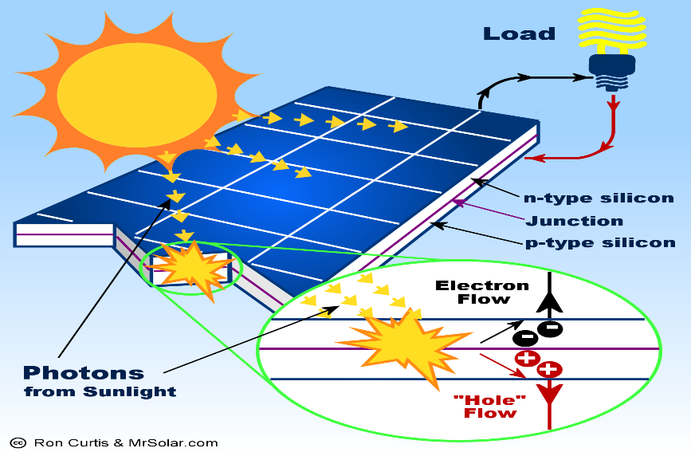
Devices
There are two basic types of device currently used to capture and utilize solar radiation:
Solar thermal collectors, which are used to heat air,
water or other liquids, depending on the application
Photovoltaic (PV) collectors, which convert
sunlight directly into electricity.

Slide 37
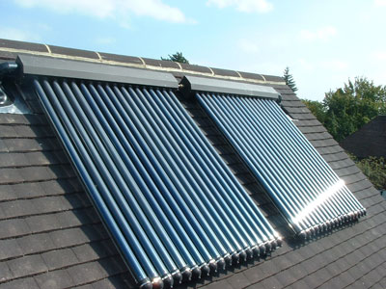
Solar thermal collector
Source: wikimedia

Slide 38
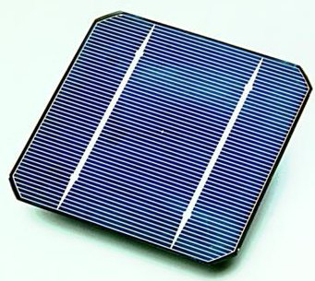
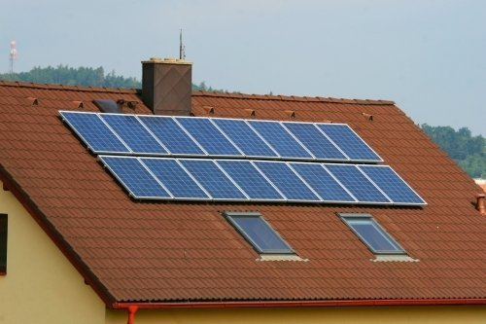
PV cell- roof top solar panels
Source: wikimedia

Slide 39
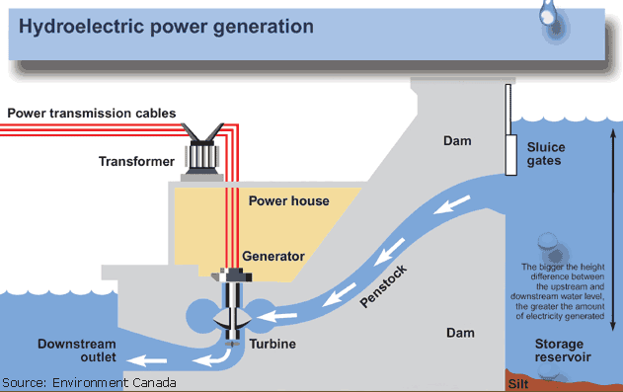
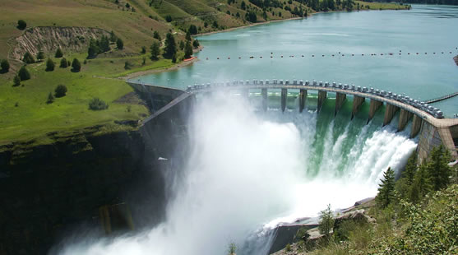
Hydropower…
Hydro helps power generation in 160 countries.
Five countries make up more than half of the world’s hydropower production: Brazil, Canada, China, Russia and the USA.
Source: wikimedia

Slide 40
The Changing Role of Hydropower
There are 45,000 large dams in the world and the majority do not have a hydro component. Need to use it for power generation
Long-term economic advantage. Operating costs minimal-autonomy from the fuel price is a distinct advantage.
Water management- multipurpose hydro reservoirs can bring security of water supply as well as power.

Slide 41
Disadvantages
Water logging
Salinity of lands
Siltation of reservoirs
Submergence of forest lands and villages
Displacement and rehabilitation of people affected
Possibility of earthquakes

Slide 42

Hydrogen energy

Slide 43
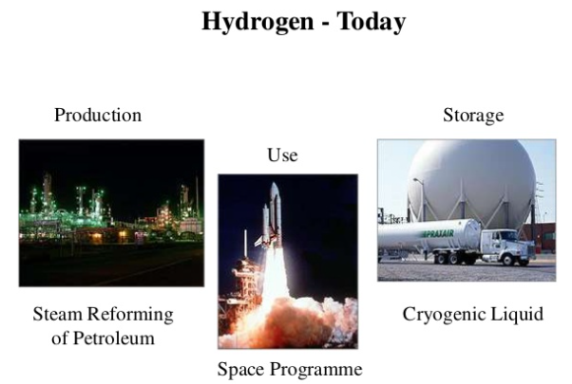
Source: wikimedia

Slide 44
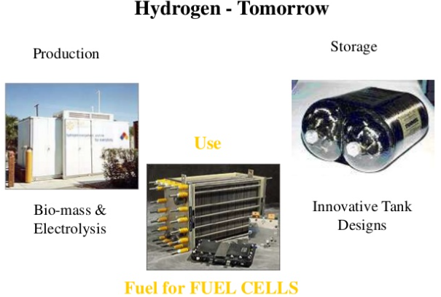
Source: wikimedia

Slide 45
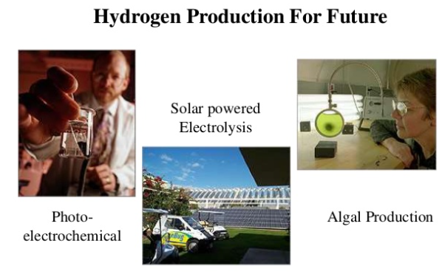
Source: wikimedia

Slide 46
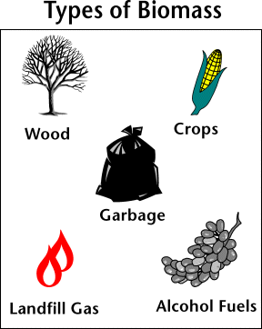
Biomass energy

Slide 47
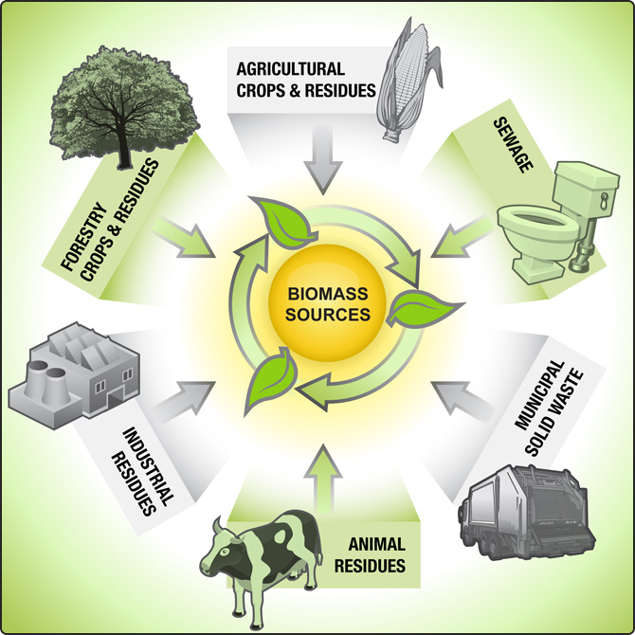
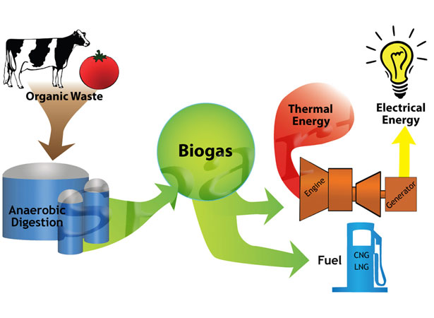

Slide 48
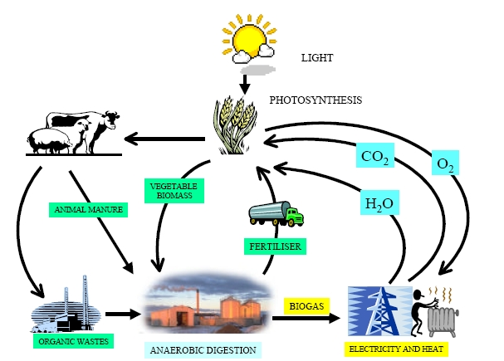
Biomass to Biogas (65%methane, 30% carbon dioxide)

Slide 49
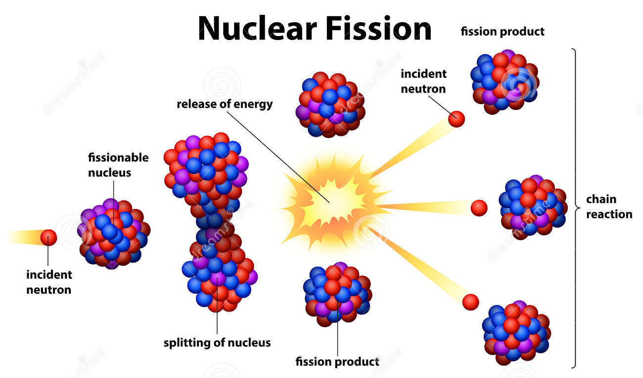
Sustainable - Nuclear Energy…
Nuclear energy is renewable and economic alternative for coal.
Alternative to fossil fuels.
Notes:
Due to bad

Slide 50
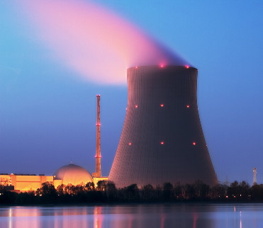
Nuclear reactor

Slide 51
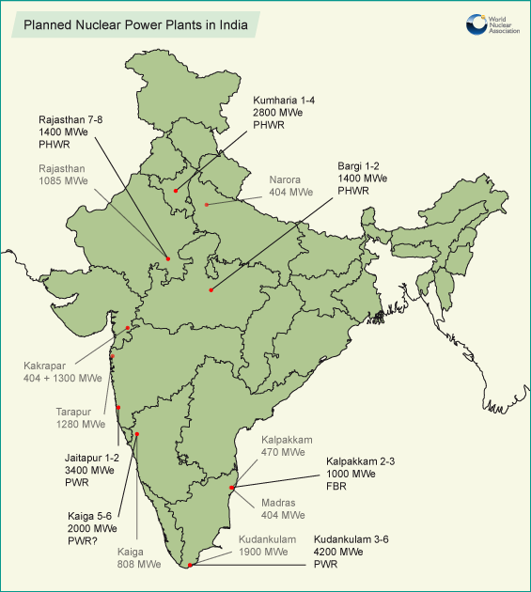
Source : World nuclear association

Slide 52
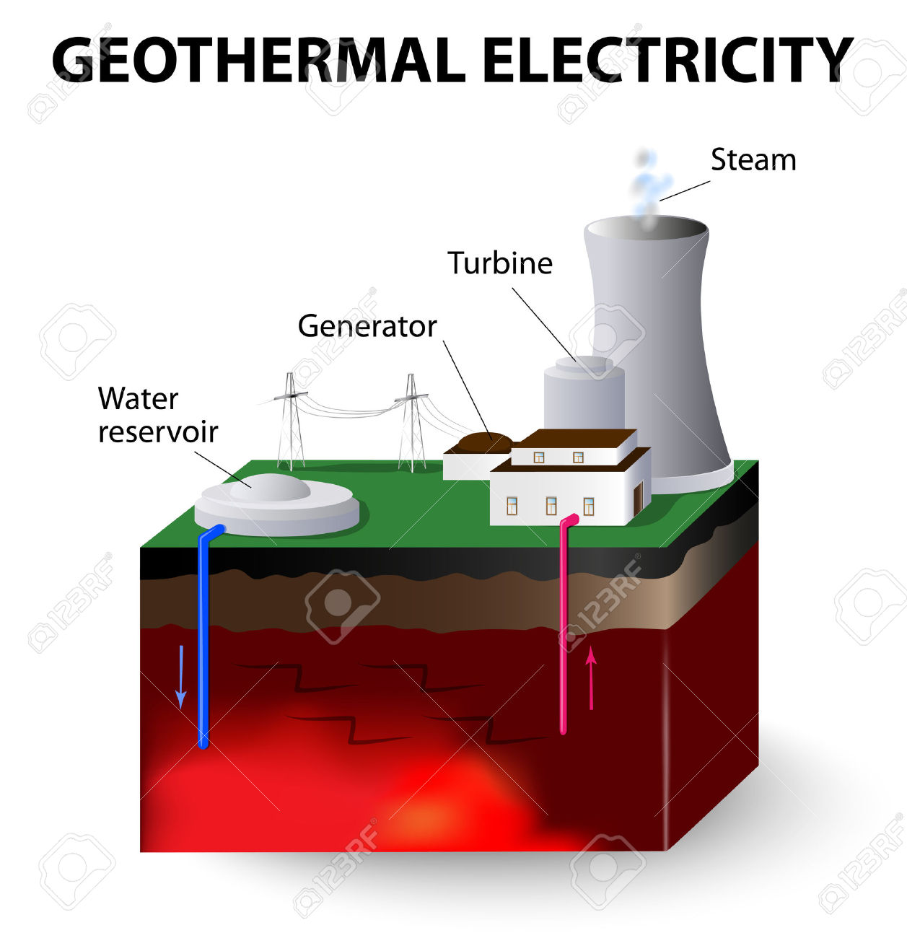
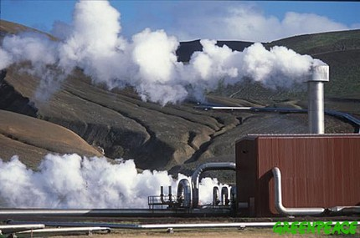
Geothermal energy
Source: wikimedia
Geothermal plant

Slide 53
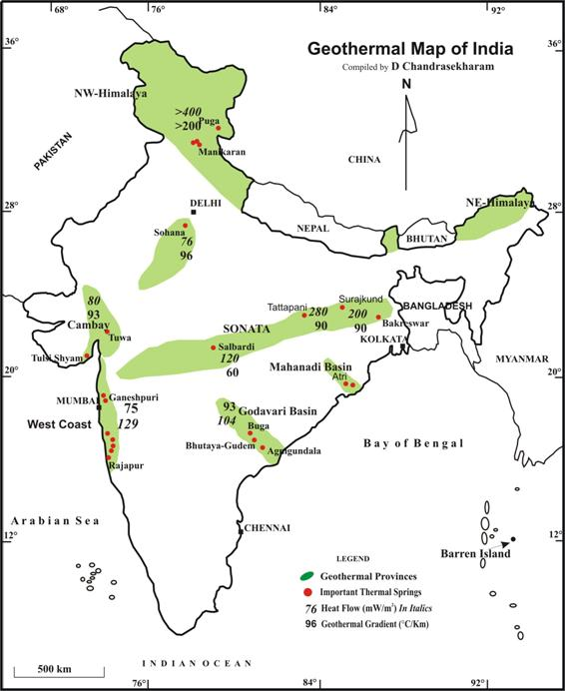
Source:http://www.geosyndicate.com/dchandra/geoenergyresource.html

Slide 54
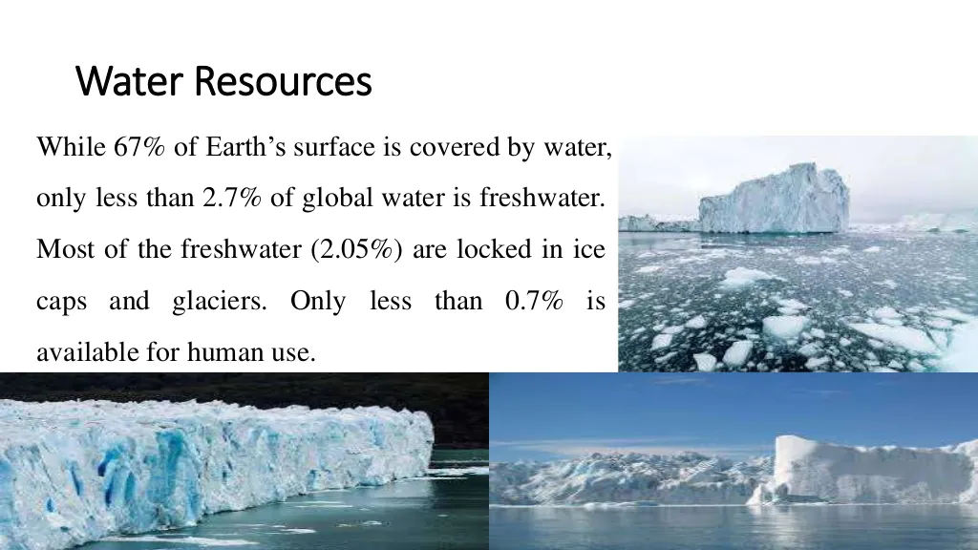

Slide 55
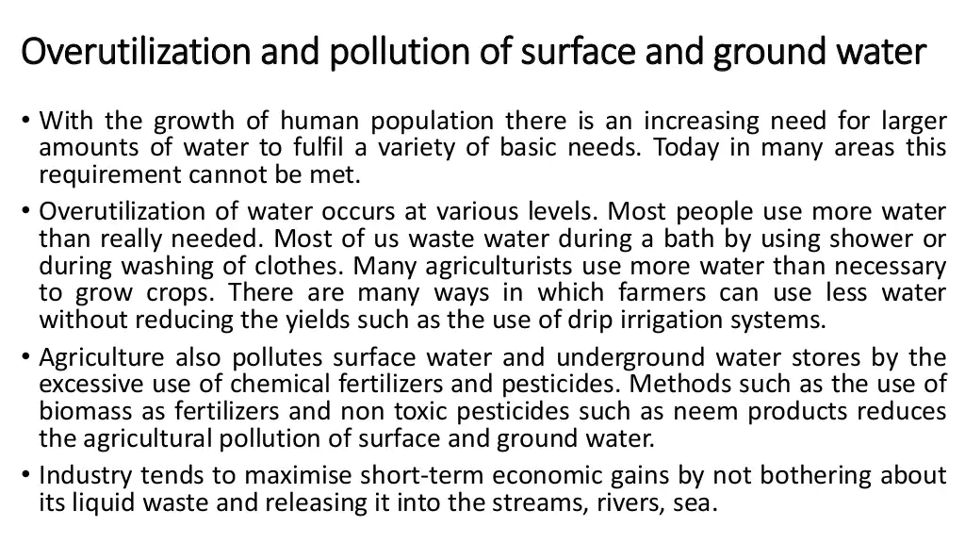

Slide 56

Water Resources
Any disturbance to the flow of the rivers causes drought or floods.
Floods are the result of peculiar rainfall pattern. Of the total annual rainfall, 75% occurs over 3-4 months. This leads to very heavy discharge from rivers which floods large areas.
Drought occur when rainfall is less than 400mm /year
Ganga-Brahmaputra-Meghna, which carry about 60% of total river flow is the most flood prone region of India. States of Assam, Bihar, Uttar Pradesh (about 19 million hectares of land) get affected almost every year by floods.
Similarly, 16% of the land area spread over 16 states is drought prone in India.

Slide 57


Slide 58


Slide 59

Watershed management

Slide 60


Slide 61
What is Rainwater Harvesting?
Rainwater harvesting is the process of augmenting the natural filtration of rainwater into the underground formation by some artificial methods.
"Conscious collection and storage of rainwater to cater to demands of water, for drinking, domestic purpose & irrigation is termed as Rainwater Harvesting”.
Why Rainwater Harvesting?
To arrest ground water, decline and augment ground water table
To beneficiate water quality in aquifers
To conserve surface water runoff during monsoon
To reduce soil erosion
To inculcate a culture of water conservation
There are two ways of harvesting rainwater:
(i) Surface runoff harvesting
(ii) Roof top rainwater harvesting

Slide 62

Surface runoff harvesting:
In urban area rainwater flows away as surface runoff. This runoff could be caught and used for recharging aquifers by adopting appropriate methods.
Waterman of India
Rajendra Singh

Slide 63

Arvari river, Rajasthan

Slide 64

Manipal lake

Slide 65

Roof top rainwater harvesting
Harvesting rainwater from roof-tops is an easy and eco-friendly method of augmenting household-level water availability.
Roof-top rainwater harvesting (RRH) involves diverting and recharging (or) storing part of the rainwater that falls on the roof of a house.
RRH for recharging groundwater is a common practice implemented in individual houses as well as apartment complexes.

Slide 66
What is the inter-linking river project?
It aims to Transfer water from surplus to water deficit areas in the country.
Inter-Linking River Program will help saving the people living in drought-prone zones from hunger and people living in flood-prone areas from the destruction caused by floods
What are the benefits?
Irrigating 35 million hectares;
Enabling full use of existing irrigation projects;
Generating power to the tune of 34,000 MW with added benefits, including flood control.
What is the cost?
Cost of the project was estimated at 5,60,000 crore.
The true cost can be known only when the detailed project reports of the 30 river link projects are drawn up
What is the problem?
Environmental problems
Exotic species
Inter-state disputes

Slide 67


Slide 68


Slide 69


India’s contribution to world mineral production
India is the world’s largest producer of mica blocks and mica splitting's.
With the recent spurt in world demand for chromite, India has stepped up its production to reach the third rank among the chromite producers of the world.
Besides, India ranks
2nd in production of coal
4th in iron ore,
6th in bauxite and manganese ore,
2nd in crude steel in the World.
Source: wikimedia

Slide 70
Types of mining
Broadly there are two types:
Surface mining
Underground mining
Environmentally surface mining creates more harm than underground mining.

Slide 71



Open Mining
Underground mining
Source: wikimedia

Slide 72


Slide 73
Environmental impacts of mining
Direct impact of the mine
Disposal of mine wastes
Transport of ores
Ore treatment or refining
Special impacts in coastal areas
Long-term problems
Direct impact of the mine
Land degradation- landslides, erosion, siltation
Disturbing landscape, forests and wildlife
Water, air, noise pollution

Slide 74
Special impacts in coastal areas
Corals and other forms of life on the bottom generally require clear water for growth.
Dredging and other forms of coastal mining destroy the immediate site and affect a much larger area through the sediment stirred up in the water.
Removing sand and gravel from the beach can also cause beach disappearance and serious coastal erosion.
Copper and other toxic materials from mines may kill most marine life in the vicinity of treatment and shipping facilities.
Long-term problems
Many islands have mining ghost towns and rusting equipment that are the only remaining signs of brief periods of prosperity (Kudremukh and Kolar).

Slide 75
Environmental protection
Government has initiated following measures to protect the environment before commencing and during any mining activity:
Detailed EIA report has to be prepared and submitted to ecological & environment dept. of GOI for clearance of mining project to safeguard the public interest.
Indian Bureau of Mines has to over see safe mining practices.
Forest dept. has to clear the mining project.

Slide 76
Environment protection during mining
Soil erosion has to be prevented by constructing suitable check-dams & planting suitable species of shrubs and trees.
Dust has to be suppressed.
The mined area has to be back-filled with excavated materials & restored to the original condition.
A green-belt has to be created.
If houses & villages are to be displaced, adequate rehabilitation and welfare measures need to be taken.

Slide 77
Land Resources
“Land” means the terrestrial bio-productive system that comprises soil, vegetation, other biota, and the ecological and hydrological processes that operate within the system.
Land is More valuable when :
Climate is pleasant,
Availability of plenty of potable water,
Clean-fresh air, flora & fauna,
Good communication facility in the form of roads and railways etc.
Scenic, educational/research value of the landscape
Similarly, if the climate is bad, full of desert conditions this resource is less valuable.

Slide 78

Soil formation
Definition of soil:
The upper layer of the ground made of unconsolidated material produced due to weathering agencies from the rocks and generally modified subsequently by a variety of mechanical, chemical and organic processes all operating constantly in a complex manner.

Slide 79
Factors controlling soil formation
Parent material
parent material is the underlying bedrock - composition affects soil types
Time
Soils get better developed (Thicker, with greater differences between layers)
with more time
Climate
Biggest control on soil formation(Key factors are temperature and precipitation)
Plants and animals
Organisms influence soil properties
Also furnish organic matter to the soil (especially plants)
Slope
Steep slopes have poorly developed soils (due to faster erosion and downslope transport)
Flatter terrain accumulates soil faster

Slide 80

An idealized soil profile with horizons
Source : www.pinterest.com

Slide 81
Soil Profile
Vertical differences are called horizons – zones or layers of soil
O horizon – organic matter
A horizon – organic and mineral matter
High biological activity (animals live here)
Together the O and A horizons make up topsoil
E horizon – little organic matter
Zone of leaching ( loss of nutrients from soil)
B horizon – zone of accumulation
C horizon – partly altered parent material

Slide 82

Eluviation : The movement of various dissolved or suspended chemicals, minerals, etc. downward through the soil due to the movement of ground water.
Soil erosion
Sheet erosion
Sheet erosion is the transport of loosened soil particles by overland flow.
Rill erosion
When sheet flows begin to concentrate on the land surface, rill erosion occurs. This type of erosion occurs when the duration or intensity of rain increases, and runoff volumes accelerate.
Gully erosion
Gully erosion occurs when runoff water accumulates, and then rapidly flows in narrow channels during or immediately after heavy rains or melting snow, removing soil to a considerable depth

Slide 83

Causes of soil erosion
Deforestation- Wind and water are the main agents
Intensive agriculture
Over grazing
Prevention and control
Source: wikimedia
Agricultural practices of controlling land degradation:
a) Crop rotation
b) Strip farming (Strip cropping or strip farming is defined as alternating crop rows between heavy-rooted plants and loosely-rooted plants to minimize erosion)
c) Ridge and furrow type of irrigation (Furrows are small, parallel channels, made to carry water in order to irrigate the crop. The crop is usually grown on the ridges between the furrows)
d) Cultivation of grassland
e) Mulches [protective layer of plants]

Slide 84





Strip farming
Ridge and furrow
3-year crop rotation
Terrace construction
Source: wikimedia
Mulches

Slide 85
Wasteland reclamation
Encourage social forestry.
Less chemicals in agricultural practices.
Construct water harvesting structures.
No crop for one season such that land recovers mineral loss.
Practice bioremediation to restore land. (Bioremediation is a waste management technique that involves the use of organisms to remove or neutralize pollutants from a contaminated site)

